Slide 1
Project Planning and Agile Methods
-By Kush Jain

Slide 2
Project Planning in Agile Methods
The Agile method of project management and software development is designed to be ready for change.
Agile project management refers to an iterative approach to planning and guiding project processes.
An Agile project is completed in small sections which are known as iterations.
It is designed to be flexible to handle projects with changing requirements.

Slide 3
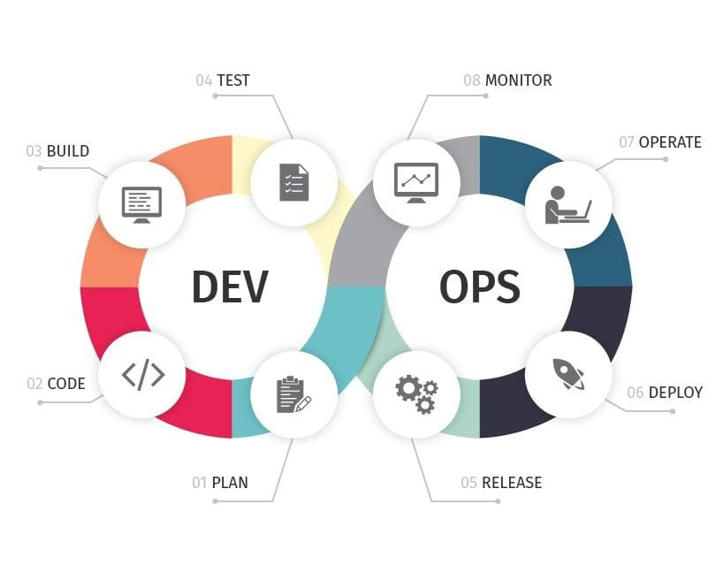
Introduction to DevOps
DevOps refers to the blending of the terms Development and Operations, representing a collaborative approach to the tasks performed by a company’s application development and IT operation teams.
It shows a culture which strategically looks at the entire software delivery chain, overseeing shared services and promoting the use of new development tools and best practices.
It involves making a company’s software-building process into an automated pipeline and optimize it for speed of delivery, ensuring security, quality and stability.
Also involves working continuously to improve the speed and feedback of the software pipeline

Slide 4
Work Breakdown Structure (WBS)
A deliverable-oriented breakdown of a project into smaller and manageable components.
Defined by the Project Management Body of Knowledge (PMBOK) as: A hierarchical decomposition of the total scope of work to be carried out by the project team to accomplish the project objectives and create the required deliverables.
The Project Management Team identifies the major functional deliverables and subdivides those deliverables into smaller systems and sub-deliverables until each sub-deliverable can be assigned to a single person only
Helps in quick development of project schedule and budget
Tracking of project cost performance for identification of problems and issues in the project is made easier by WBS

Slide 5
Agile Development
It is a practice which promotes continuous iteration of development and testing throughout the software development lifecycle of the project
Software is built incrementally from the start of the project, instead of trying to deliver all at once
Agile development can incorporate changing requirements of the user, making it more dynamic
Shortest timescale deliverables are preferred
Early and continuous delivery of valuable software to customer is the highest priority

Slide 6
Effort Estimation in Agile Projects
Story Points: Relative effort of work is rated in a Fibonacci-like format (0.0.5, 1, 2, 3, 5, 8 and so on), instead of the traditional time format (days, weeks, months). They take the non-project related work, such as emails and meetings into account.
Agile estimation involves the whole team – designers, testers, developers etc. to get accurate estimates for each task.
Planning Poker: A technique to get accurate estimates for each task. Each member formulates an estimate for an item on a card and after various discussions and explanations behind a difference in estimate (if it occurs) the story points to the task are allotted.
If a task estimate is beyond 16 hours of work time (an arbitrary allotment of 20 story points), then that task needs to be broken down in smaller tasks

Slide 7
Agile v/s Waterfall method of Development
Agile Development
Waterfall Development
Incremental and iterative approach
Broken down into individual models
Customer can make changes at early stages of development, if required
Unstructured
Difficult to estimate development time for larger projects
Testers and developers work together, because each iteration has its testing phase
Errors can be fixed in the middle of the project
Sequential approach of development from start to end
Not broken down into individual models
Customer sees the product at the end of the project
Plan oriented
All projects can be estimated well
Testers and developers work separately, because separate parts are not functional, unlike agile development
In case of errors, the project debugging has to start from beginning

Slide 8
Continuous Delivery, Continuous Integration
Continuous Integration (CI): Requires developers to integrate code in a shared repository several times a day.
Continuous Delivery (CD): It focuses on automating the software delivery process so that teams can easily and confidently deploy their code to production at any time.
The regular integration of code allows quicker error detection due to less back-tracking
Less time is spent in debugging and more time can be spent in adding features
Software can be delivered more rapidly
This cycle of continuous development, integration and development helps to deliver software to users quickly and locate and find errors faster, thus completing the project within the deadline

Slide 9
Travis CI
Allows you to sync GitHub projects for easy testing of open source code
As a continuous integration platform, Travis CI supports your development process by automatically building and testing code changes, providing immediate feedback on the success of the change
It can also manage deployments and notifications
When a build is run, Travis CI clones your GitHub repository into a brand new virtual environment and carries out a series of tasks to build and test your code.
The build ‘passes’ if none of the tasks fail, else it is considered ‘broken’.
Further information can be obtained on the Travis CI official documentation website.

Slide 10
Bibliography
Work Breakdown Structure (WBS) (2019), Retrieved from: https://www.workbreakdownstructure.com/
What is DevOps? (2019), Retrieved from: https://searchitoperations.techtarget.com/definition/DevOps
DevOps in 3 Sentences – DEV Community , by Ash Isaac, (30 Nov, 2018), Retrieved from: https://dev.to/ashokisaac/devops-in-3-sentences-17c4
Agile Software Development (2019), Retrieved from: https://www.geeksforgeeks.org/software-engineering-agile-software-development/#_=_
The secrets behind behind story points and agile estimation, by Dan Radigan (2019), Retrieved from: https://www.atlassian.com/agile/project-management/estimation
Agile Methodology & Model: Guide for Software Development & Testing (2019), Retrieved from: https://www.guru99.com/agile-scrum-extreme-testing.html
Continuous Integration (2019), Retrieved from: https://www.thoughtworks.com/continuous-integration
What is CI/CD? Continuous integration and continuous delivery explained, by Isaac Sacolick (Posted on May 10, 2018), Retrieved from: https://www.infoworld.com/article/3271126/what-is-cicd-continuous-integration-and-continuous-delivery-explained.html
An Introduction to Continuous Integration, Delivery, and Deployment, by Justin Ellingwood (Posted on May 10, 2017), Retrieved from: https://www.digitalocean.com/community/tutorials/an-introduction-to-continuous-integration-delivery-and-deployment
Test and Deploy with Confidence, (2019), Retrieved from: https://travis-ci.org/
Core Concepts for Beginners (2019), Retrieved from: https://docs.travis-ci.com/user/for-beginners/0

